Slide 1
IRE 317
Control System Engineering
Sadia Enam
Lecturer, IRE
University of Frontier Technology, Bangladesh

Slide 2
Signal Flow Graph
The process of block diagram reduction is time consuming as at every stage modified block diagram is to be redrawn. A simple method was developed by S.J Mason known as Signal Flow Graph. This method is very simple and does not go through any redraw process. It is applicable for liner systems.
Basic Elements of Signal Flow Graph
Nodes and branches are the two basic elements of a Signal Flow Graph.
It is a point that represents a variable or a signal. There are three types of nodes:
Input Node
Output Node
Mixed Node.
To identify a node, in Signal Flow Graph it mainly represents with circles, dots, you can find it in below images.
Input Node: It is a node where we provide only inputs and it has only outgoing branches. To identify the input node, always follow the arrow, if it enters the node then it is input node.
Output Node: It is a node that has only incoming branches. To identify the output node, always follow the arrow, if it goes out from node then it is output node.
Mixed Node: It is a node that has both incoming and outgoing branches. To identify the mixed node, always follow the arrow, if it has both incoming and outgoing arrow then it is mixed node.

Slide 3
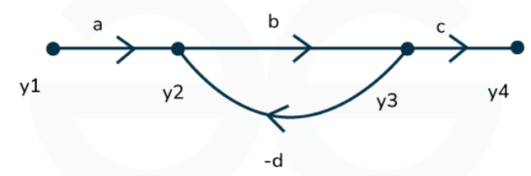
Signal Flow Graph
Branch
It is a line segment which joins two nodes. Since we use this in electronics equipment, which likewise has gain in both positive and negative, also it has directions, we must provide them the branch in order to finish our signal flow graph. Let's use a little diagram to ensure we grasp this properly.
Here we can see the black dots (y1, y2, y3, y4) they are the nodes of the Signal flow graph, and the lines are the branches. As we see that these branches has some directions that is defined by the arrow symbols. So, we can say a,b,c are the positive gain branches and the d is negative gain branch that is why it is in negative sign.

Slide 4
Signal Flow Graph
Characteristics of SFG
Nodes
Branches or Edges
Forward Paths
Single Loops
Non-touching Loops
Mason Gain Formula

Slide 5
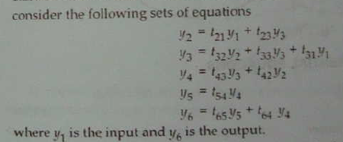
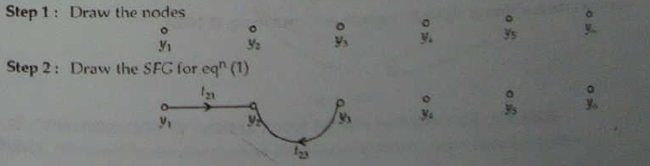
Signal Flow Graph
Construct a SFG from a set of equations

Slide 6
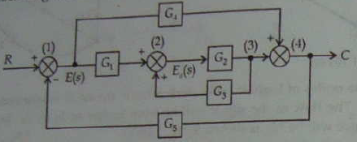
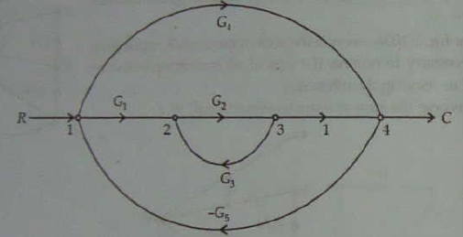
Signal Flow Graph
Construct SFG from block diagram

Slide 7
Signal Flow Graph
Mason Gain Formula:
The Mason’s Gain Formula is a mathematical tool used in control system engineering to calculate the overall transfer function of a signal flow graph.
Basic Elements of Signal Flow Graph related to Mason Gain Formula
Nodes, which we already discussed.
Directed edges, as you can see the above image with the directed arrows.
Forward paths, which are started and ended on different nodes.
Loops, which are the close paths in SFG, stared and ended in same node, but passed throw other nodes as well. A SFG can contain many loops.
Non-touching loops: If there are two or more loops in a single SFG, then they do not touch each other.

Slide 8
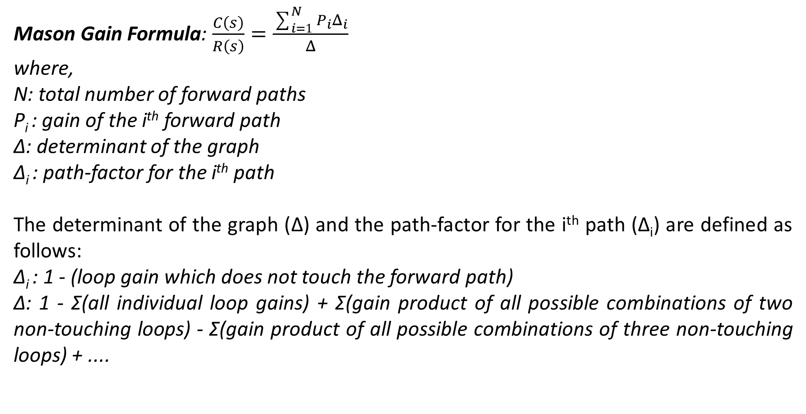
Signal Flow Graph

Slide 9
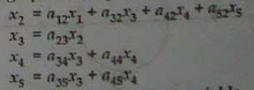
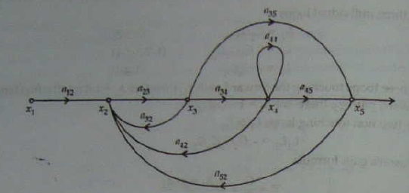
Signal Flow Graph
For the system represented in figure find the T/F by the help of SFG technique

Slide 10
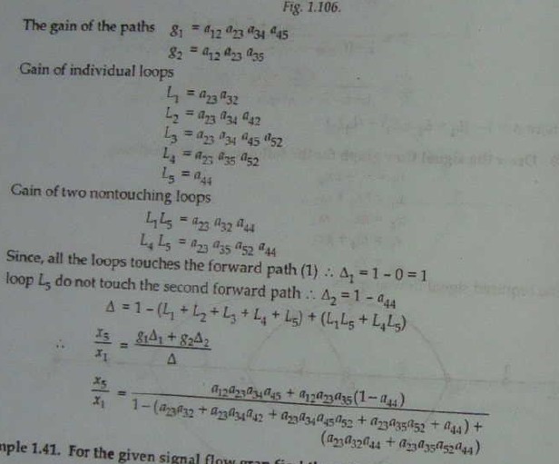
Signal Flow Graph

Slide 11
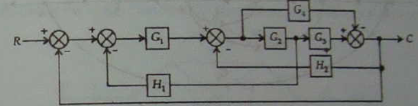
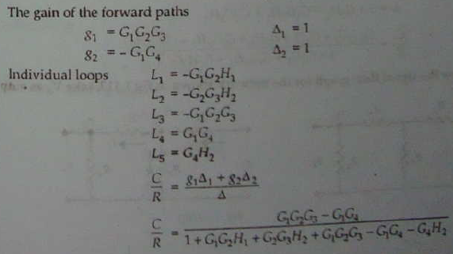
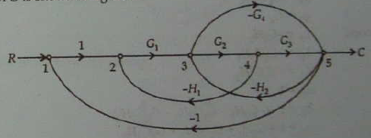
Signal Flow Graph
Draw the SFG and determine C/R for the block diagram shown in figure.

Slide 12
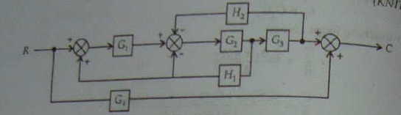
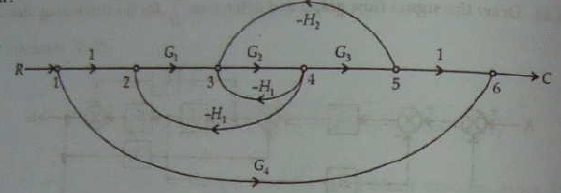
Signal Flow Graph
Draw the SFG and determine C/R for the block diagram shown in figure.

Slide 13
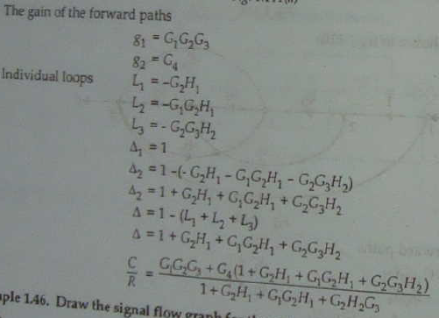
Signal Flow Graph

